Slide 1
Making AI know your business: assistants on your own documents
How does AI answer from our policies, products and files, and how far can we trust what it says?
Leading with AI | Session 8 of the 15 (Sessions 0 to 14)
KLAi Professional Learning | Jotham Martin Wambi
Notes:
Welcome back. In Session 7 you learned to brief an AI assistant well: a role, the context, examples, the format and the limits, then a test on real tasks. Today we hit the wall every organisation meets next. The assistant writes well, yet it has never read your policies, your price list or your files.
So the question is: how does AI answer from our own documents, and how far can we trust what it says?
We will build the idea as an open-book test, tour six industries, watch recorded runs on a fictional staff handbook, and add a knowledge assistant to your portfolio.

Slide 2



Today in one view: what you will leave with
By the end of today you will have
Say in plain words how an assistant answers from your own documents: find the right pages, answer from them, show the source
Choose the right first step for a knowledge assistant: paste the document, retrieve the pages, or customise the model
Add a knowledge assistant to your AI Opportunity Portfolio, with its documents and the person who owns them
Notes:
That question gives three things you will be able to do by the end. You will say, in plain words, how an assistant answers from your documents: it finds the right pages, answers from them and shows the source. You will choose the right first step for your own case: paste the document, retrieve the pages, or customise the model, and know why customising comes last.
And your portfolio will hold a knowledge assistant, with its documents and the person who owns them.

Slide 3

Your two hours: the idea, the industries,
a demonstration, then your own portfolio
I show recorded runs on a fictional staff handbook. You plan an assistant on your own documents.
Notes:
Here is how the two hours run. Ten minutes to recall Session 7 and meet today’s question. Forty minutes on the idea, one picture at a time, then six industries and three real cases. Fifteen minutes of demonstration on recorded runs. A five-minute break. Ten minutes on your people and the questions to ask.
Then twenty-five minutes on your own portfolio, five on your decision, and ten to close. First, how today fits the course, and five words.

Slide 4

Three questions from last time
1. In Session 7, what goes into a good brief for an AI assistant?
2. How do you know a brief works before your team relies on it?
3. What is the jagged frontier?
Answer aloud first. Then we check together.
Notes:
Three quick questions from Session 7. Answer aloud first, and then we check together. It is a warm-up to bring last time back.
Question one. In Session 7, what goes into a good brief for an AI assistant? Take a moment.
A good answer is this. A role, the context, an example or two, the format you want, and the limits.
Question two. How do you know a brief works before your team relies on it? Say it to yourself first.
A good answer is this. Test it on a small set of real tasks whose good answers you already know.
Question three. What is the jagged frontier? Think about your own work as you answer.
A good answer is this. AI is excellent at some tasks and worse than your staff at others, even tasks that look alike, so you test each one.
If an answer was missing, last session’s take-away sheet or workbook page has it. Now to today.

Slide 5
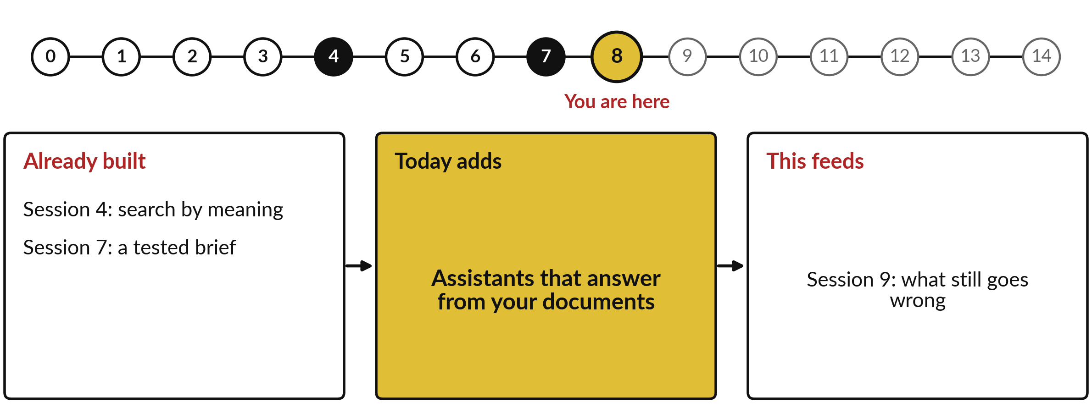
How today connects: what we
already have and what it feeds
Each session is built on the ones before it.
Notes:
So where does today sit in the story? The dots along the top are the fifteen sessions, from the map at Session 0 to your plan at Session 14, and the gold one is today.
We already hold search by meaning from Session 4 and a tested brief from Session 7. Nothing today starts from zero.
What today adds is this: assistants that answer from your documents.
And it feeds straight into what comes next. Session 9: what still goes wrong. Keep that chain in mind, because each idea you learn today is a step on it.

Slide 6



Words we use today
Word | What it means
Knowledge base | The collection of your own documents an assistant may answer from: policies, product sheets, past reports.
Retrieval | Finding the pages closest in meaning to a question, as search by meaning did in Session 4.
RAG | Retrieval-augmented generation: find the right pages first, then write the answer from them.
Context window | How much text an assistant can read at once, your question and pages included.
Fine-tuning | Further training of an existing model on your own examples, as in Session 6. It changes habits and style, not facts.
Notes:
Five words for today. I give the plain meaning of each, and we use every one of them before the end of the session.
Knowledge base. The collection of your own documents an assistant may answer from: policies, product sheets, past reports.
Retrieval. Finding the pages closest in meaning to a question, as search by meaning did in Session 4.
RAG. Retrieval-augmented generation: find the right pages first, then write the answer from them.
Context window. How much text an assistant can read at once, your question and pages included.
Fine-tuning. Further training of an existing model on your own examples, as in Session 6. It changes habits and style, not facts.
Keep those words close. The first idea uses them straight away, so let us begin.

Slide 7
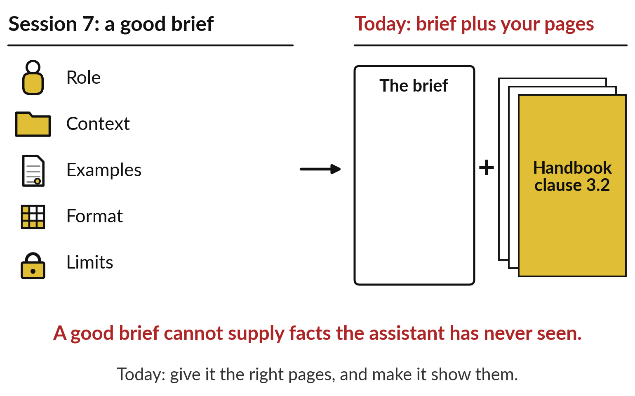
From Session 7 to today: a good
brief, now with your own documents
A brief shapes how the assistant works. Your documents give it the facts.
Session 7: role, context, examples, format, limits.
Today: the brief, plus the right pages.
Without the pages, it can only guess or decline.
Notes:
Those five words all serve one need, and you met half of it last session. In Session 7 you wrote a good brief: a role, the context, examples, the format and the limits. On the left is that brief. It shapes how the assistant works. It cannot give the assistant facts it has never seen.
Ask who approves an expense claim of one and a half million shillings, and the brief alone has no answer, because the answer sits in clause 3.2 of your handbook. On the right is today: the same brief, plus the right pages. So who has already done this at scale?

Slide 8
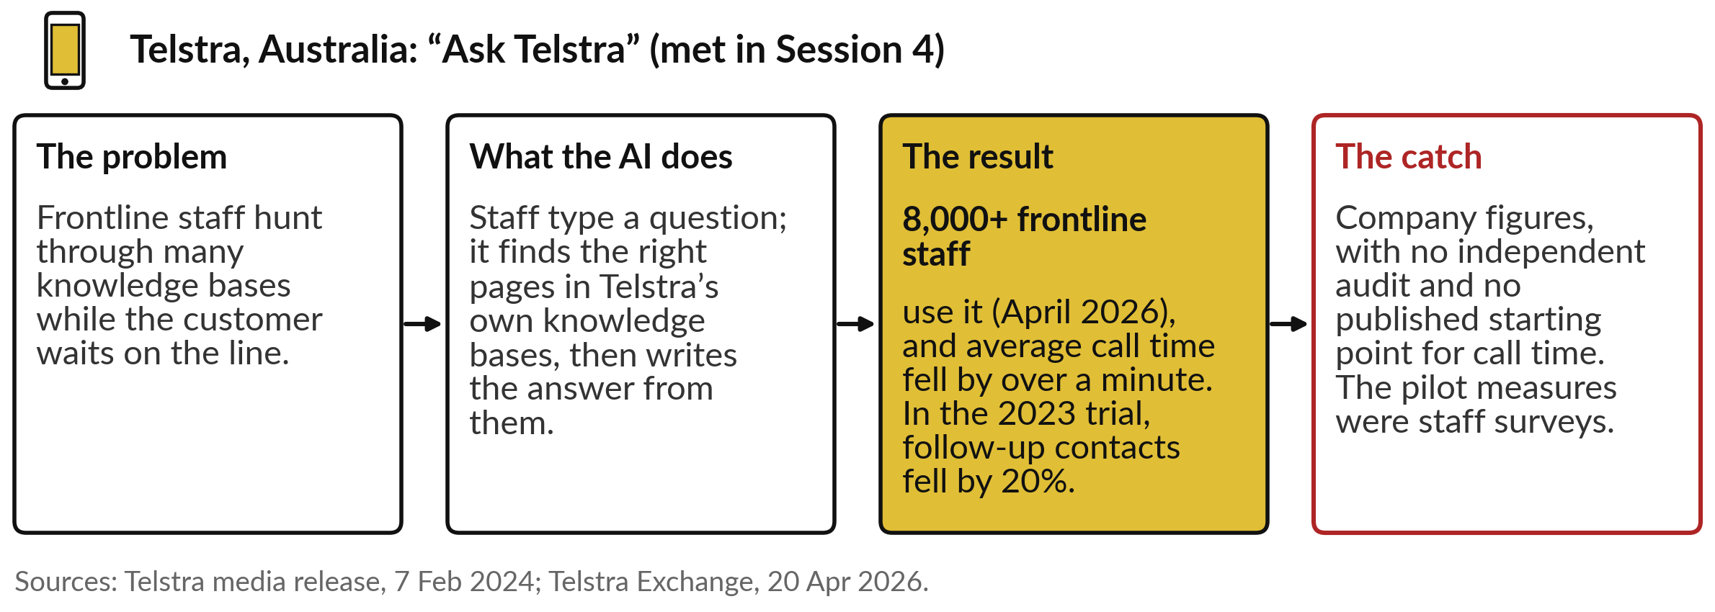
Telstra, from Session 4: staff ask the company’s
own knowledge, and the assistant writes the answer
Today’s question: how does AI answer from our policies, products and files?
Notes:
You met Telstra, the Australian telecom company, in Session 4. Its frontline staff no longer hunt through many knowledge bases while a customer waits: they ask in plain words, and the tool searches by meaning. Look now at the second half. Ask Telstra does not stop at finding pages; it writes the answer from them.
That second half is today’s subject: an assistant that answers from your own documents. The figures are the ones you saw: by April 2026 more than 8,000 frontline staff used it, and Telstra says average call time fell by over a minute. The catch is the same too: company figures, no independent audit, and no published starting point.
So how does such a tool work, from the question to the answer?

Slide 9
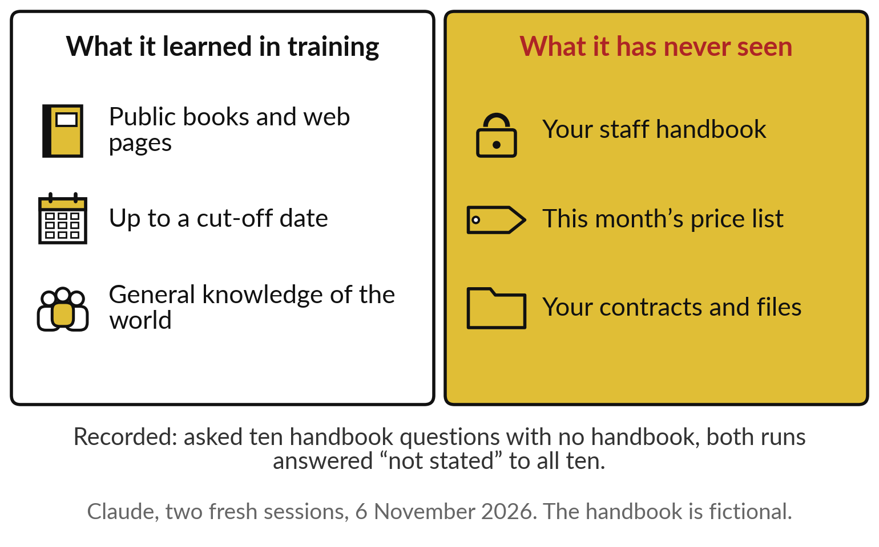
A general assistant knows what it read in
training, and has never seen your handbook
Training gave it the public world. Your files were never in it.
It learned from public text, up to a date.
Your handbook, prices and contracts are private.
Asked about them, a careful tool says it cannot know.
Notes:
Start with what a general assistant knows. As Session 5 showed, it learned to write from a huge library of public text, up to a cut-off date. On the left: books, web pages, general knowledge. On the right: what it has never seen. Your staff handbook, this month’s price list, your contracts.
Those are private, so they were never in its training. In our recorded runs, when we asked ten questions about a fictional staff handbook and gave no handbook, both runs answered not stated to all ten. That is the careful outcome. A less careful tool guesses, and Session 5 showed how sure a guess can sound. So we must hand it the pages.

Slide 10
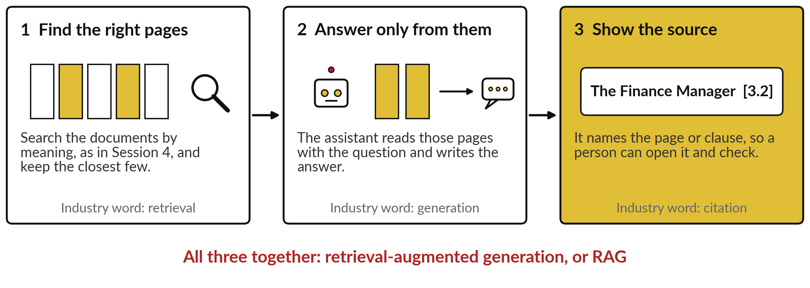
The fix is an open-book test: find the right
pages, answer from them, and show the source
Like a good student in an open-book test: look it up, answer from the page, quote the page.
Notes:
Think of an open-book test. A good student does three things. First, finds the right pages in the book. Second, answers from those pages, and from nothing else. Third, quotes the page, so anyone can check. An assistant on your documents does the same. Step one is called retrieval: it searches your documents by meaning, as in Session 4, and keeps the closest few pages.
Step two is generation: it writes the answer from those pages. Step three is the citation: the clause or page it used. Together the industry calls this retrieval-augmented generation, RAG for short. When a vendor says RAG, this picture is what they mean. Let me show each step on real runs.

Slide 11
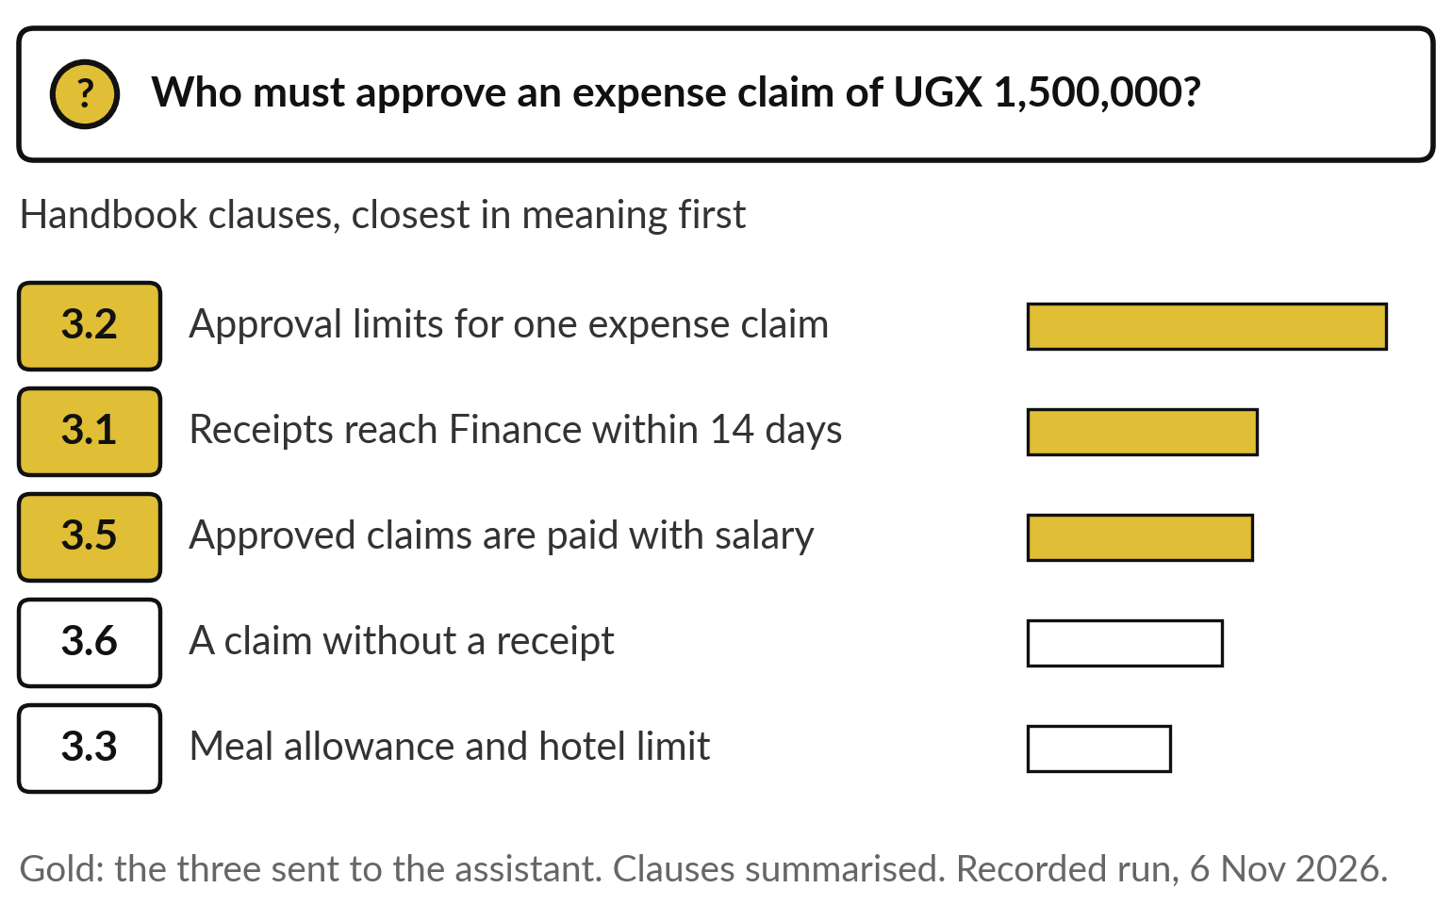
Step one ranks every page by how
close its meaning is to the question
The closest pages go to the assistant. The rest stay on the shelf.
Search by meaning, from Session 4.
The right clause, 3.2, came top.
Here the three closest go forward.
Notes:
Here is step one on a recorded run. The handbook of Nile Valley Foods, our fictional company, was cut into thirty pieces, one per numbered clause. The question: who must approve an expense claim of UGX 1,500,000?
The search compared the meaning of the question with every clause, as in Session 4, and ranked them. The longer the bar, the closer the meaning. Clause 3.2, on approval limits, came top, well ahead of the next. Then 3.1 on receipts and 3.5 on when claims are paid, which share words but hold no answer.
The three closest, in gold, go to the assistant. The others stay on the shelf. Now step two.

Slide 12
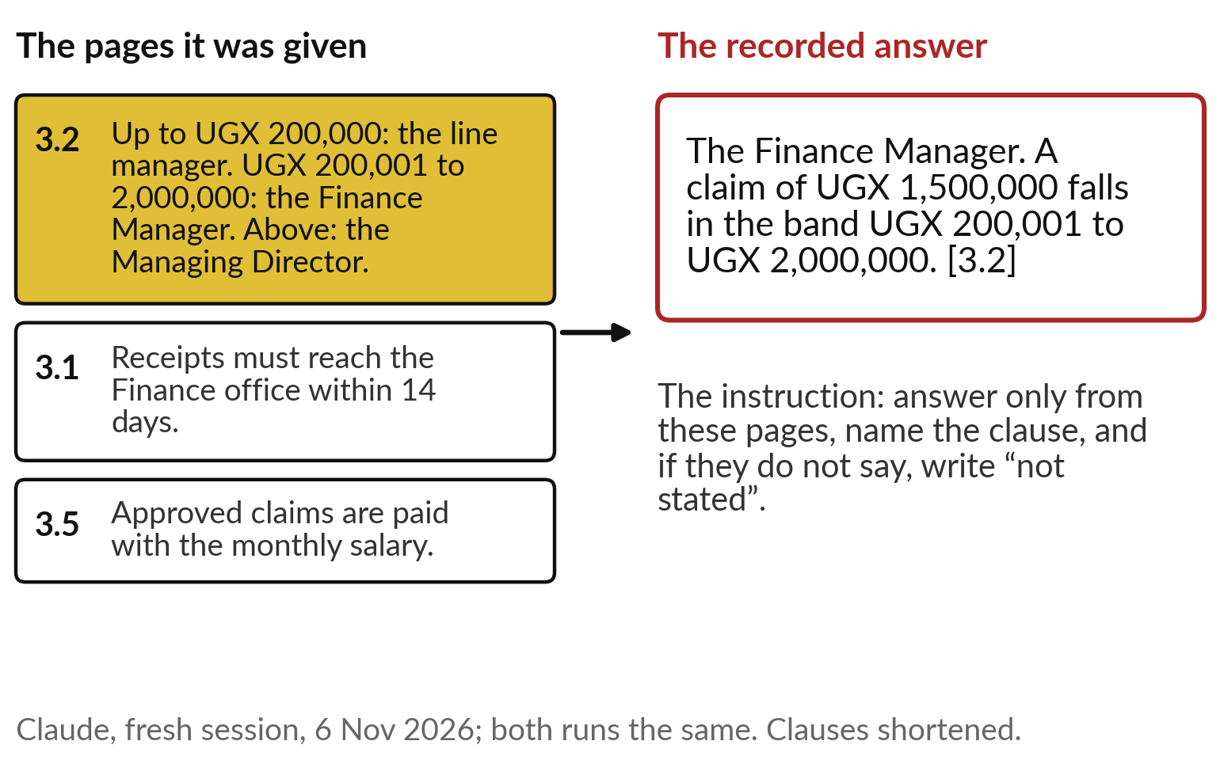
Step two answers only from those
pages, and names the clause it used
One instruction does the work: answer only from these pages, or say “not stated”.
It picked the right band from clause 3.2.
It named the clause, so anyone can check.
The same answer in both runs.
Notes:
With three clauses in hand, the assistant writes. The instruction is short: answer only from these pages, name the clause, and if the pages do not say, write not stated. On the left are the three clauses it received, shortened. On the right is the recorded answer: the Finance Manager, because one and a half million falls in the band from 200,001 to two million shillings, clause 3.2.
Two things matter for a leader. It worked out the band from the page; nobody wrote that answer down in advance. And it named the clause, so any member of staff can open the handbook and check. Both runs gave the same answer. But everything depends on the pages being right.

Slide 13
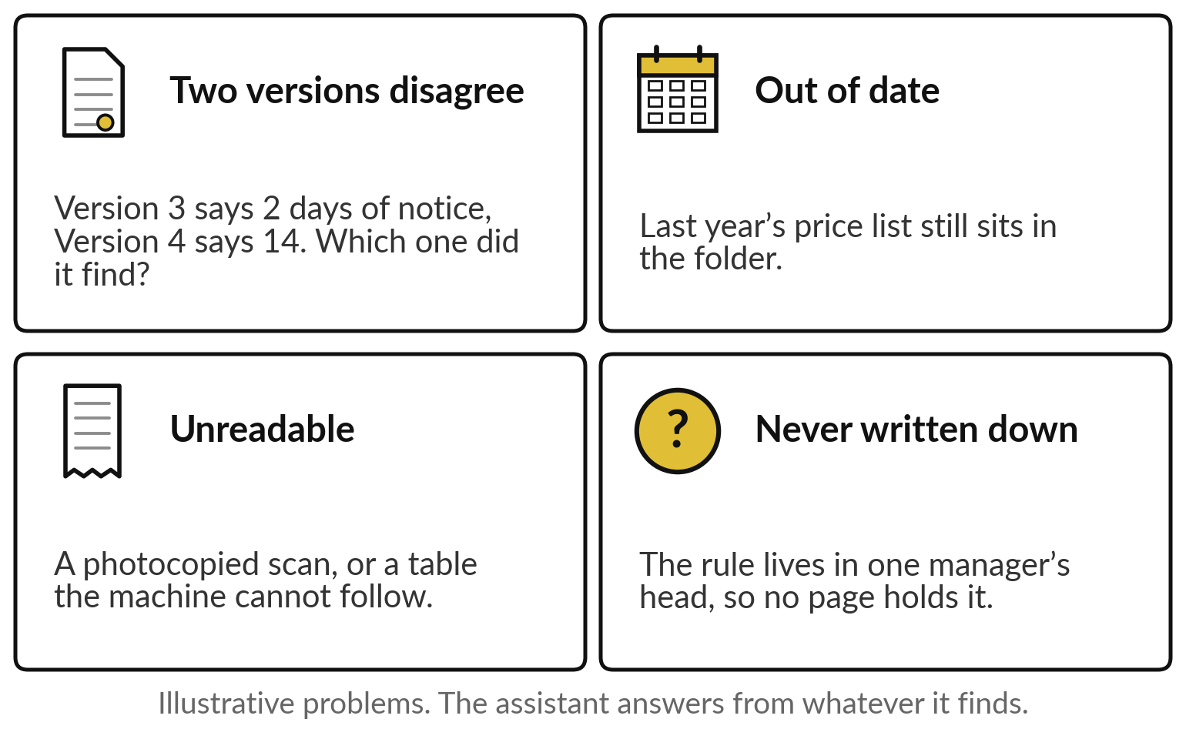
Messy documents give messy answers
The assistant answers from whatever it finds, right or wrong.
Two versions that disagree.
Pages out of date.
Scans it cannot read; rules never written down.
Notes:
The assistant answers from whatever it finds, so the state of your documents becomes the quality of its answers. Four problems appear in most organisations, and these examples are illustrative. Two versions disagree: version 3 says two days of notice, version 4 says fourteen. Which one did it find?
Out of date: last year’s price list still sits in the folder. Unreadable: a photocopied scan or a table the machine cannot follow. And never written down: the rule lives in one manager’s head, so no page holds it. Digital Green’s farm chatbot in Kenya left about one question in four unanswered, mostly because its library had gaps. And even tidy documents can be cut badly.

Slide 14
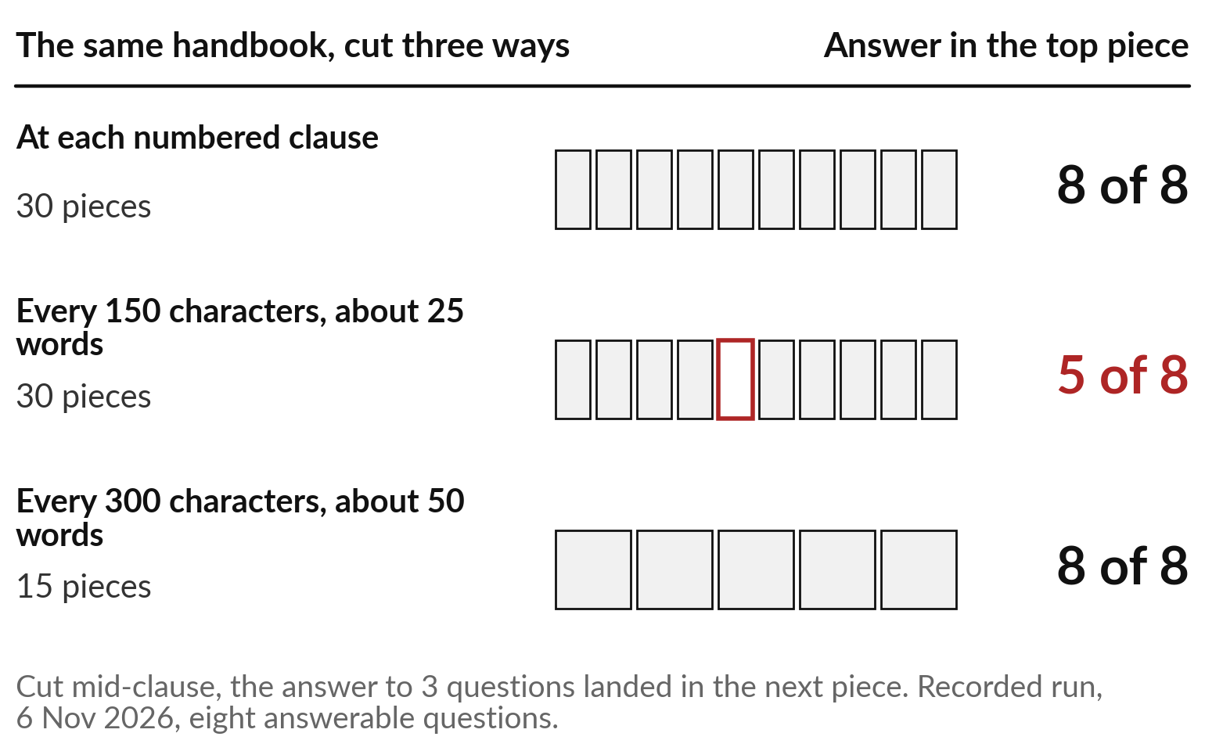
Where you cut the pages decides what can be
found: 8 of 8 by clause, 5 of 8 in short slices
Cut along the document’s own sections, and check.
By clause: 8 of 8 found.
Every 25 words or so: 5 of 8.
Larger slices: 8 of 8 again.
Notes:
Before the search, the documents are cut into pieces, which the industry calls chunks. Where you cut matters, and here is a recorded test on the same handbook and the eight questions it can answer. Cut at each numbered clause: the top piece held the whole answer for 8 of 8.
Cut every 150 characters, about 25 words: only 5 of 8, because a clause was split and its answer landed in the next piece. Cut every 300 characters: 8 of 8 again. The lesson is practical. Cut along your document’s own sections, keep headings with their text, and test it on questions with known answers.
And when the document is short, you may not need to cut at all.

Slide 15
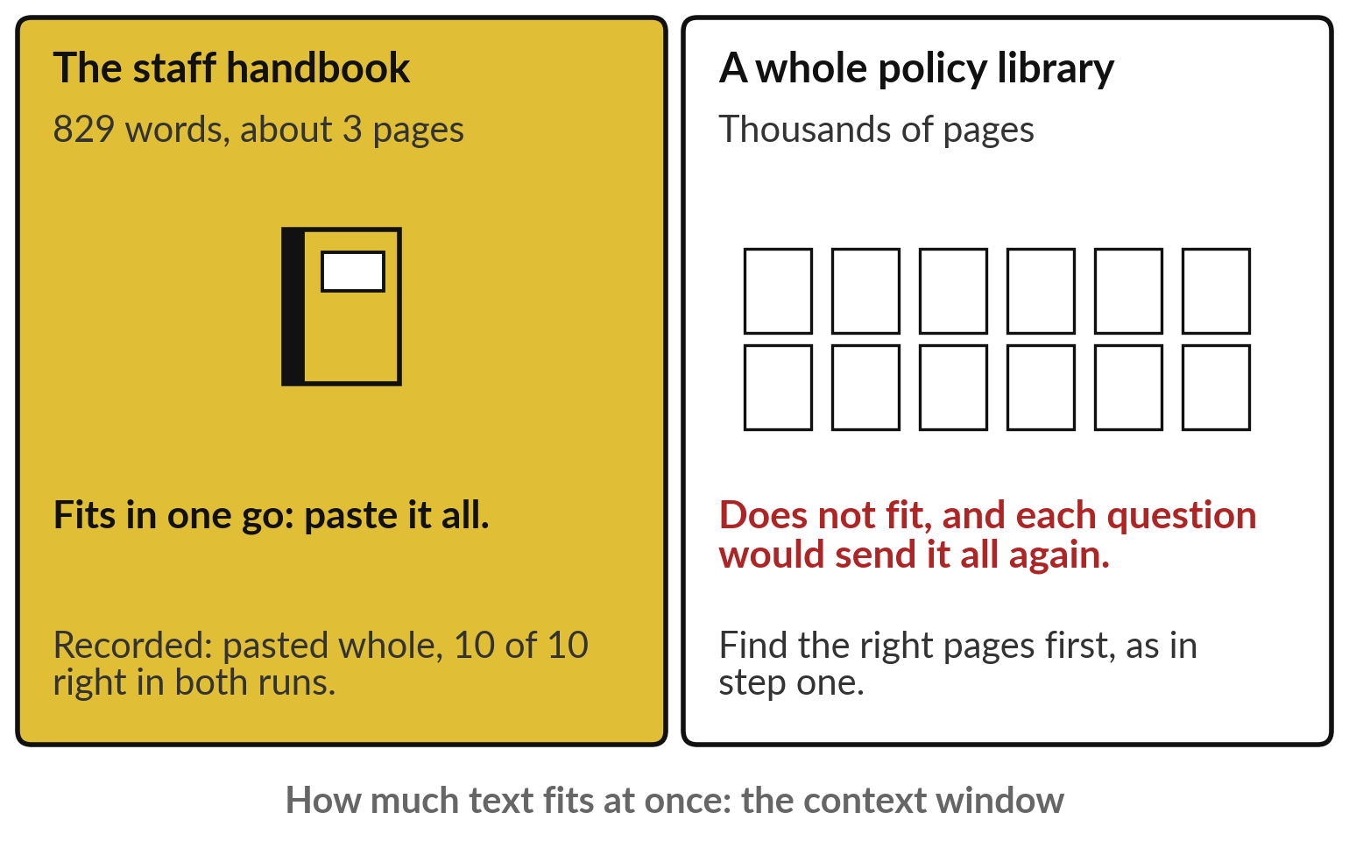
A short document can simply be pasted in whole
If it fits, paste it all. If it does not, find the pages first.
The handbook: 829 words, about 3 pages.
Pasted whole: 10 of 10 in both runs.
A library of thousands of pages needs retrieval.
Notes:
Not every case needs a search. An assistant can read a certain amount of text at once, your question and pages included, and the industry calls that the context window. Today’s assistants accept long documents. Our handbook is 829 words, about three pages, so we pasted the whole of it, and both recorded runs got 10 of 10.
That is the simplest route, and often the right first one. A whole policy library is different: thousands of pages will not fit, and each question would send everything again, which is slower and usually dearer. There, find the right pages first. One more route remains, the one vendors like to sell: customising the model.

Slide 16
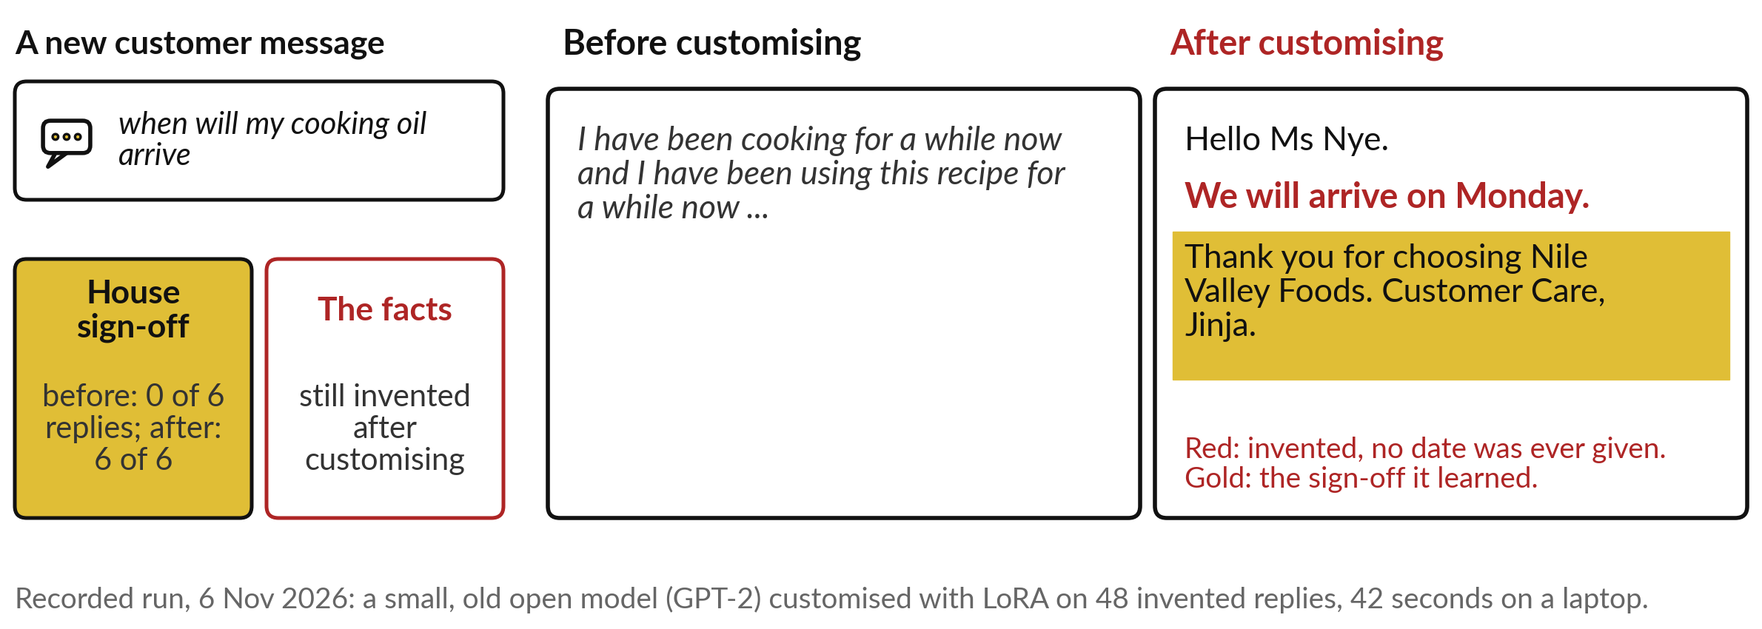
Customising a model teaches it a
style, and it still invents the facts
Use customising for a house style or format at volume. Facts come from your documents.
Notes:
Customising means fine-tuning, which you met in Session 6: training an existing model further on your own examples, as Sunbird did. A cheaper way that changes only a small share of the model is called LoRA, short for low-rank adaptation, and you only need the name. Here is a recorded run.
A small, old open model learned from 48 invented customer replies written in one house style, in 42 seconds on a laptop. Before, it rambled. After, all six new replies ended with the house sign-off, against none before. Now read the middle: we will arrive on Monday. No date was ever given to it.
It learned how we write, and it still invented what happened. Customising teaches style; facts come from your pages.

Slide 17
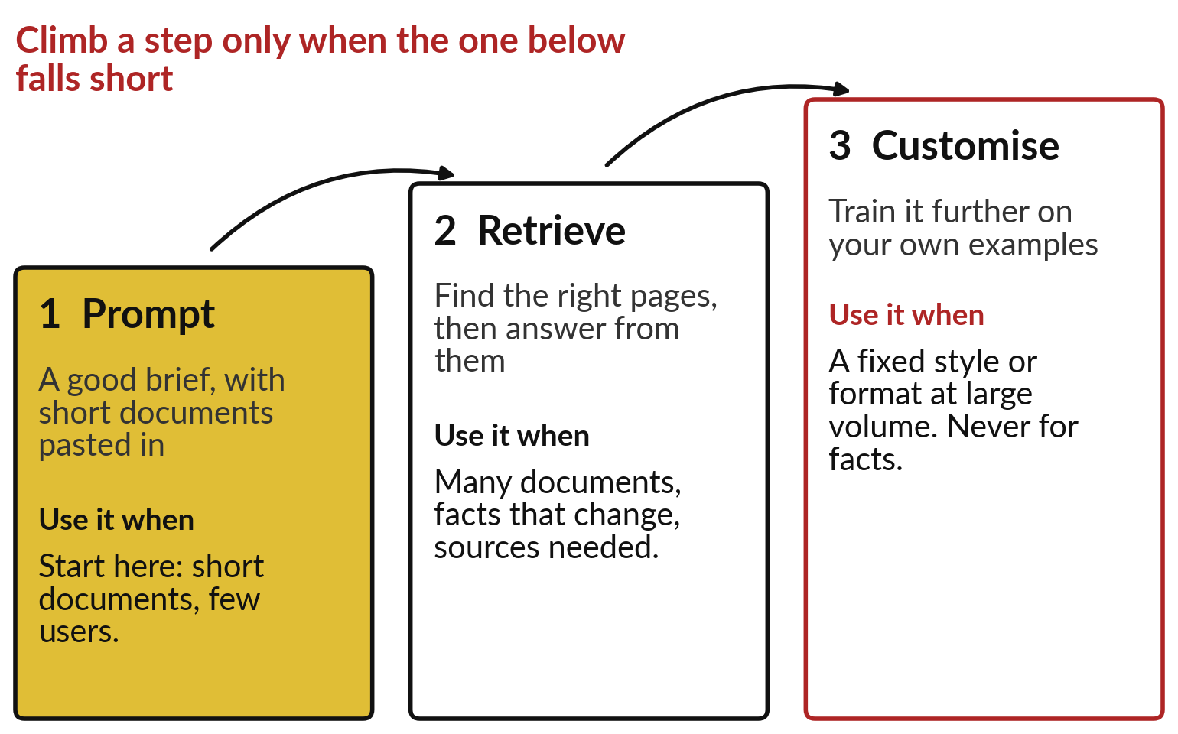
The climb: prompt first, then
retrieve, then customise
Start on the lowest step that does the job.
Prompt: a good brief, short documents pasted in.
Retrieve: many documents, changing facts, sources.
Customise: a style at volume, never for facts.
Notes:
Put the three routes together and you have a climb. Step one, prompt: a good brief from Session 7, with short documents pasted in. It is cheap, quick and easy to change, so start there. Step two, retrieve: when the documents are many, change often, or each answer must show its source.
Step three, customise: only when you need a fixed style or format at large volume, and never to teach facts, because, as we just saw, it still invents them. Climb a step only when the one below falls short, and test at each step on questions whose answers you know.
Your decision sheet today is this picture. So where is the method strong and where weak?

Slide 18
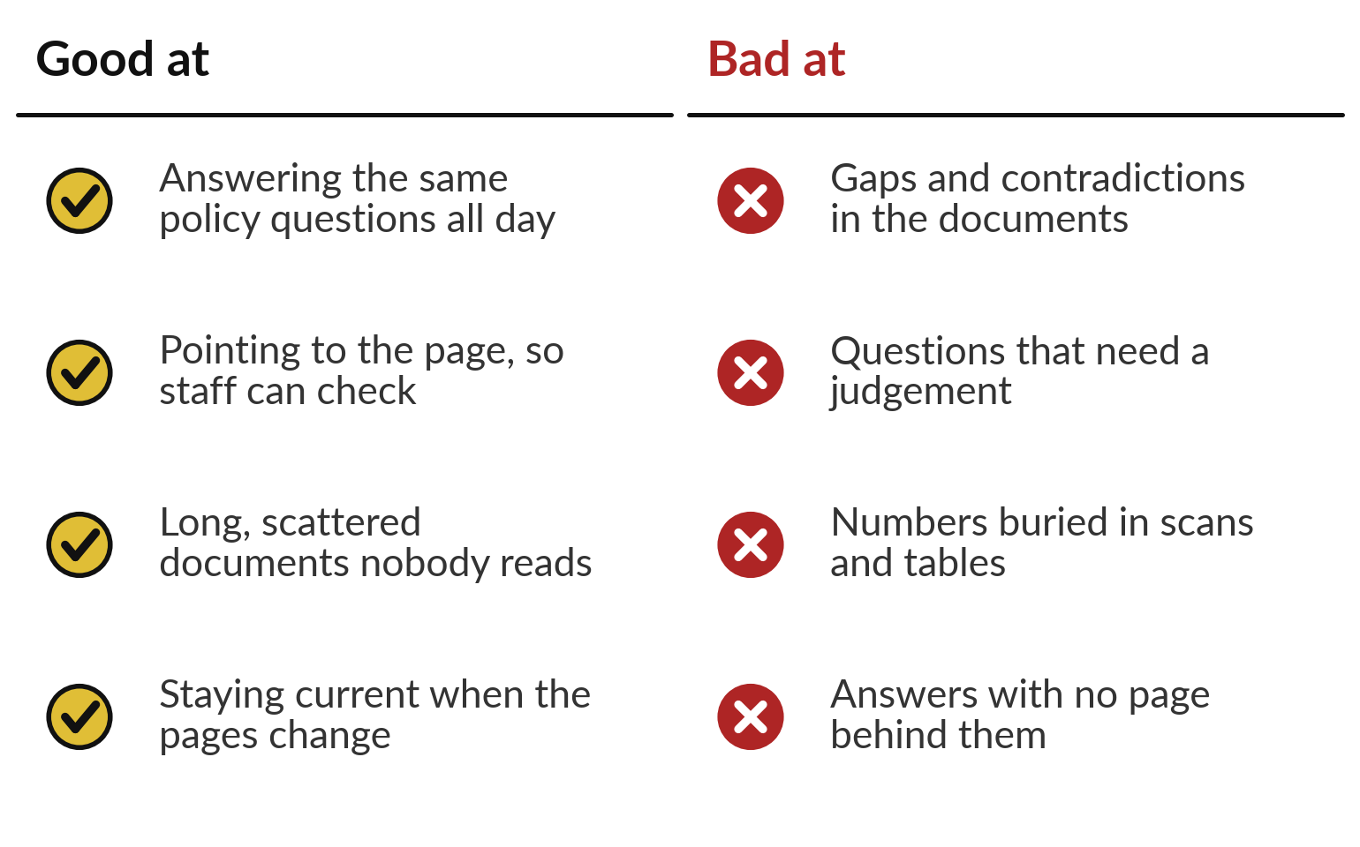
Assistants on your documents are good at repeat
questions, and bad where the pages are thin
Use it where the answer is written down and asked for often.
Strong: repeat questions, long documents, pointing to the page.
Weak: gaps, contradictions, judgement calls.
Notes:
Here is the balance. Assistants on your documents are good at the same policy questions asked all day, at long scattered documents nobody reads end to end, at pointing to the page so staff can check, and at staying current, because you change the page and the next answer changes with it.
They are bad where the pages are thin: gaps and contradictions, questions that need a judgement the documents do not make, numbers buried in scans and tables, and any answer with no page behind it. So the best first uses are written rules asked about often. Which organisations have found those?

Slide 19
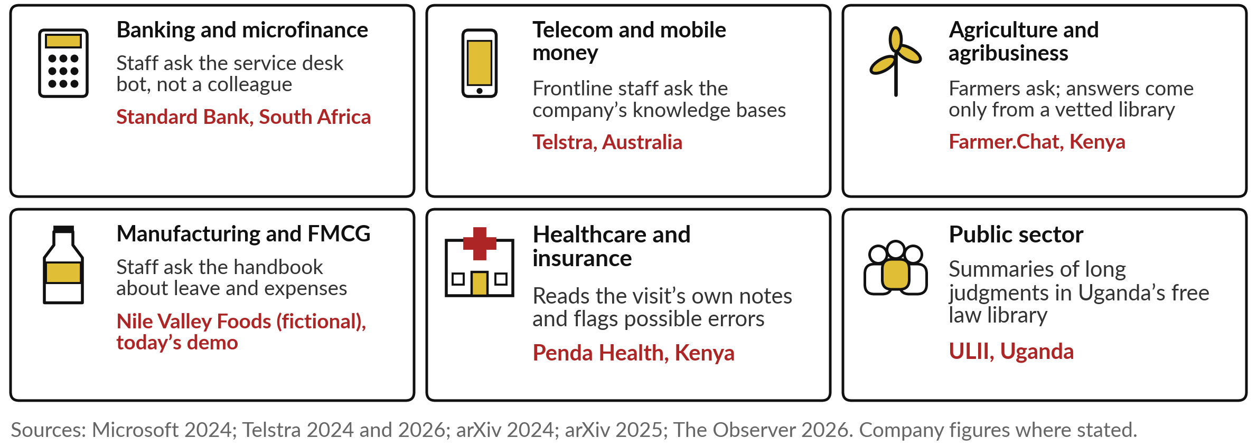
Answers from your own documents in six
industries, with one named example in each
Three of them follow as stories: Morgan Stanley, Kisan e-Mitra and McKinsey.
Notes:
Here is today’s idea in the six main industries. In banking, Standard Bank, the group that owns Stanbic in Uganda, gives staff a service-desk bot for IT questions. In telecom, Telstra, our opening case. In agriculture, Digital Green’s Farmer.Chat in Kenya answers farmers only from a vetted library of farming advice.
In manufacturing and FMCG, I use our fictional Nile Valley Foods and its staff handbook, today’s demonstration. In health, Penda Health in Nairobi has an assistant read each visit’s notes and flag possible errors for the clinician. And in the public sector, Uganda’s free law library, ULII, now offers AI summaries of long judgments.
Find your own industry’s tile. Three stories follow, starting with a bank.

Slide 20
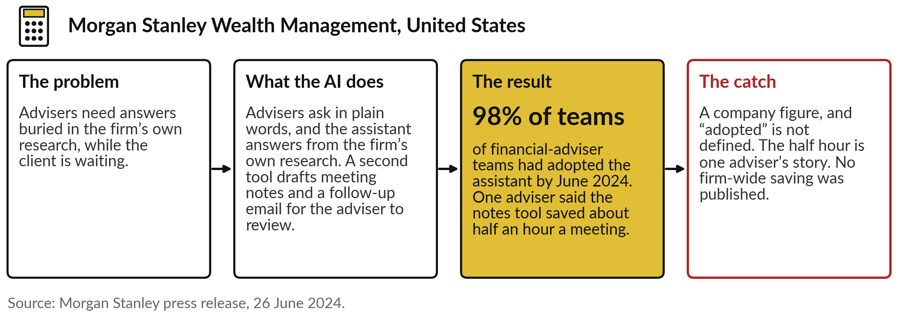
Morgan Stanley: advisers ask the firm’s
own research, and 98% of teams adopted it
The adviser reviews every draft before anything reaches the client.
Notes:
The first story is a bank. Morgan Stanley’s financial advisers need answers buried in the firm’s own research, often while a client is waiting. Its assistant lets them ask in plain words and answers from that research. A second tool takes meeting notes, with the client’s consent, and drafts a follow-up email, which the adviser reviews before anything is sent.
By June 2024 the bank said 98 per cent of adviser teams had adopted the assistant. The catch: that is a company figure, and adopted is not defined. One adviser said the notes tool saved about half an hour a meeting, which is one person’s story, and no firm-wide saving was published. The second story is about farmers.

Slide 21
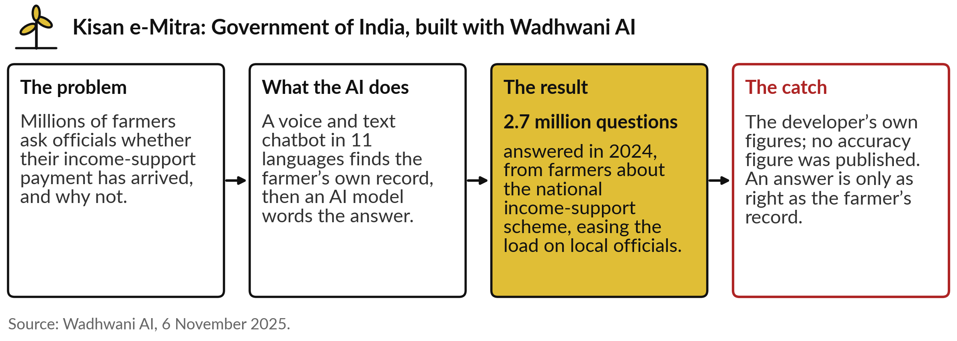
Kisan e-Mitra, India: farmers ask about
their own payments, in 11 languages
Here the “document” is the farmer’s own record in the scheme.
Notes:
The second story is public service for farmers. India pays small farmers an income-support grant, and millions of them ask officials the same questions: has my payment arrived, and if not, why?
Kisan e-Mitra, built for the Ministry of Agriculture with Wadhwani AI, answers by voice or text in 11 languages. It first finds the farmer’s own record in the scheme, then an AI model words the answer. That is our open book again, with the farmer’s record as the page.
In 2024 it answered about 2.7 million questions, easing the load on local officials. The catch: these are the developer’s figures, no accuracy figure was published, and an answer is only as right as the record behind it.

Slide 22
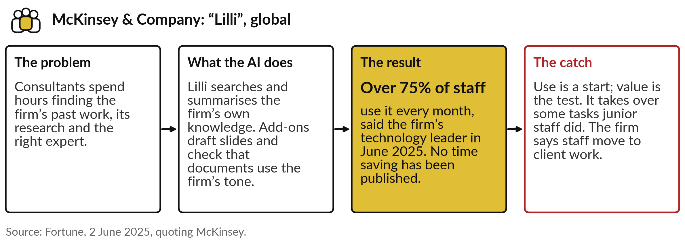
McKinsey’s Lilli: three in four staff use it
monthly, and its value is still to be shown
Measure what changes for the client and the business, beyond how many use it.
Notes:
The third story is a consulting firm, and it carries a warning. McKinsey’s consultants spent hours finding past work, research and the right expert. Lilli searches and summarises the firm’s own knowledge, and add-ons draft slides and check that documents use the firm’s tone. In June 2025 the firm’s technology leader said over 75 per cent of staff use it every month.
The catch: use is a start, and value is the test, and no time saving was published. Fortune also reported that it takes over some tasks junior staff used to do, while the firm says those staff move to client work. Keep both lessons. Now let me show you the idea working on recorded runs.

Slide 23
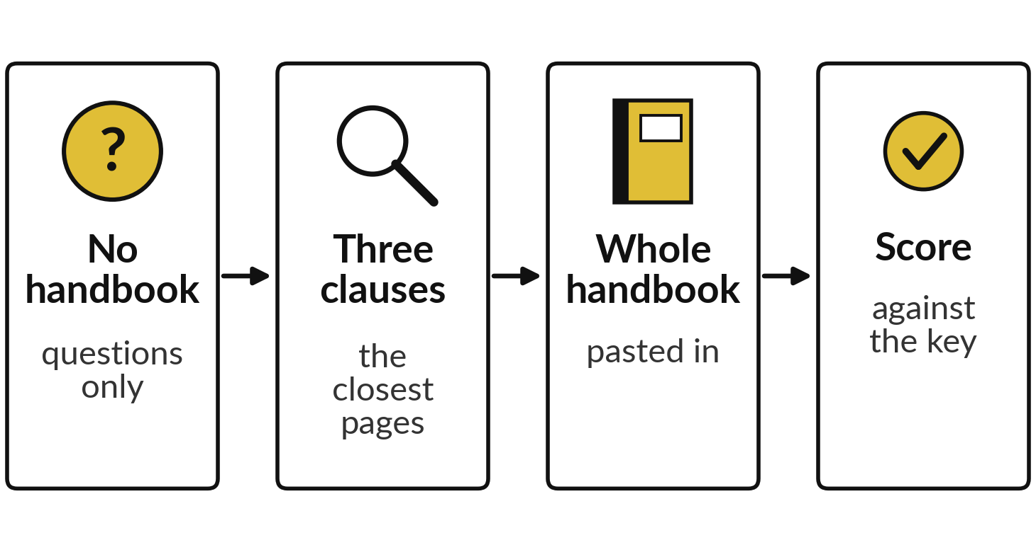
Demonstration: ten handbook
questions, answered three ways
I will show
Watch for
How many of ten each way got right
What it does when the handbook is silent
Whether any run invents an answer
Notes:
Now the three routes side by side, on recorded runs. Nile Valley Foods, our fictional company, has a staff handbook of about three pages. I wrote ten questions about it, and agreed the right answers before any run. Two of the ten have no answer in the handbook, on purpose.
The same ten questions went to an assistant three ways: with no handbook, with the three closest clauses for each question, and with the whole handbook pasted in. Each way ran twice, in fresh sessions of Claude, on the 4th and 6th of November 2026. Watch three things: how many each way got right, what it does when the handbook is silent, and whether any run invents an answer.

Slide 24
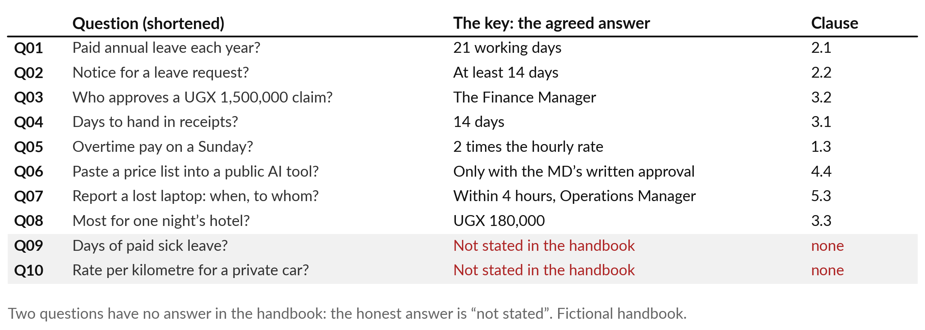
The ten questions, and the
answers agreed before any run
The agreed answers are the key. Two honest answers are “not stated”.
Notes:
Here are the ten questions, shortened, with the agreed answer and the clause where each is found. Leave, notice, approval limits, receipts, overtime, a rule on public AI tools, a lost laptop and a hotel limit. Look at the last two, shaded. Question nine asks how many days of paid sick leave staff get, and question ten asks the rate per kilometre for a private car.
The handbook says neither. So the right answer to both is not stated, and an assistant that offers a number has invented it. We call the agreed answers the key; Session 9 builds a set like this for your own documents. Now the scores, question by question.

Slide 25
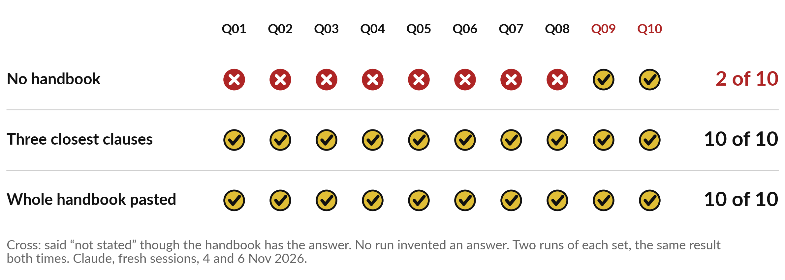
With no handbook, 2 of 10; with the three closest
clauses, 10 of 10; with the whole handbook, 10 of 10
Given the right pages, the same assistant went from 2 to 10 right out of 10.
Notes:
Here is every answer. With no handbook, the runs said not stated to all ten. That matched the key only on the two questions with no answer, so 2 of 10, and they invented nothing. With the three closest clauses for each question, 10 of 10, in both runs.
With the whole handbook pasted in, 10 of 10 as well. So the same assistant went from 2 to 10 right out of 10, only by being given the right pages. For a three-page handbook, pasting it whole did as well as searching it. The careful no-handbook runs show one more thing.
Declining beats guessing. But what happens when the closest page holds no answer?

Slide 26
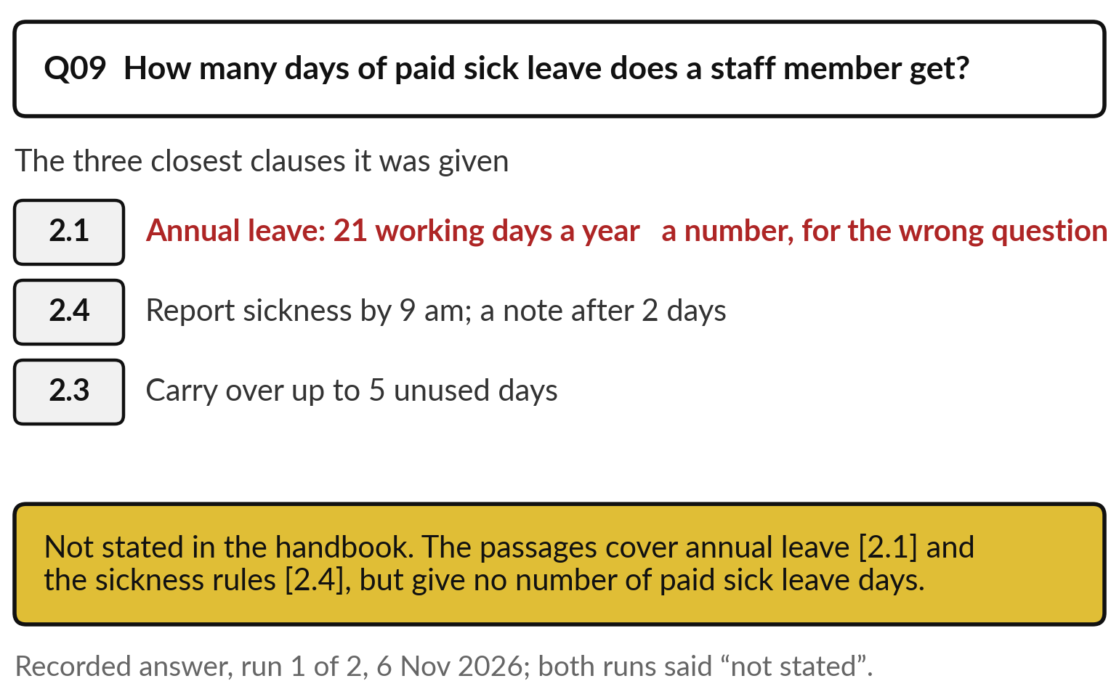
Where the handbook is silent, the runs said “not
stated”, even with a near-miss page in hand
The closest page can hold a number that answers a different question.
Sick leave: the closest clause gave 21 days of annual leave.
Both runs said “not stated”.
Session 9: when the right page is missed.
Notes:
Here is question nine, paid sick leave, the trap in the set. The search sent its three closest clauses. The closest was 2.1, annual leave, with a tempting number: 21 working days. Then 2.4 on reporting sickness, and 2.3 on carrying leave over. None says how many sick days staff get.
Both recorded runs said not stated, and named the clauses they had read. That is what the instruction asked for when the pages are silent. Without it, a tool could easily answer 21 days, a confident answer from the wrong page. Session 9 calls this failure a retrieval miss and shows how to check for it. Now to the people whose work this changes.

Slide 27
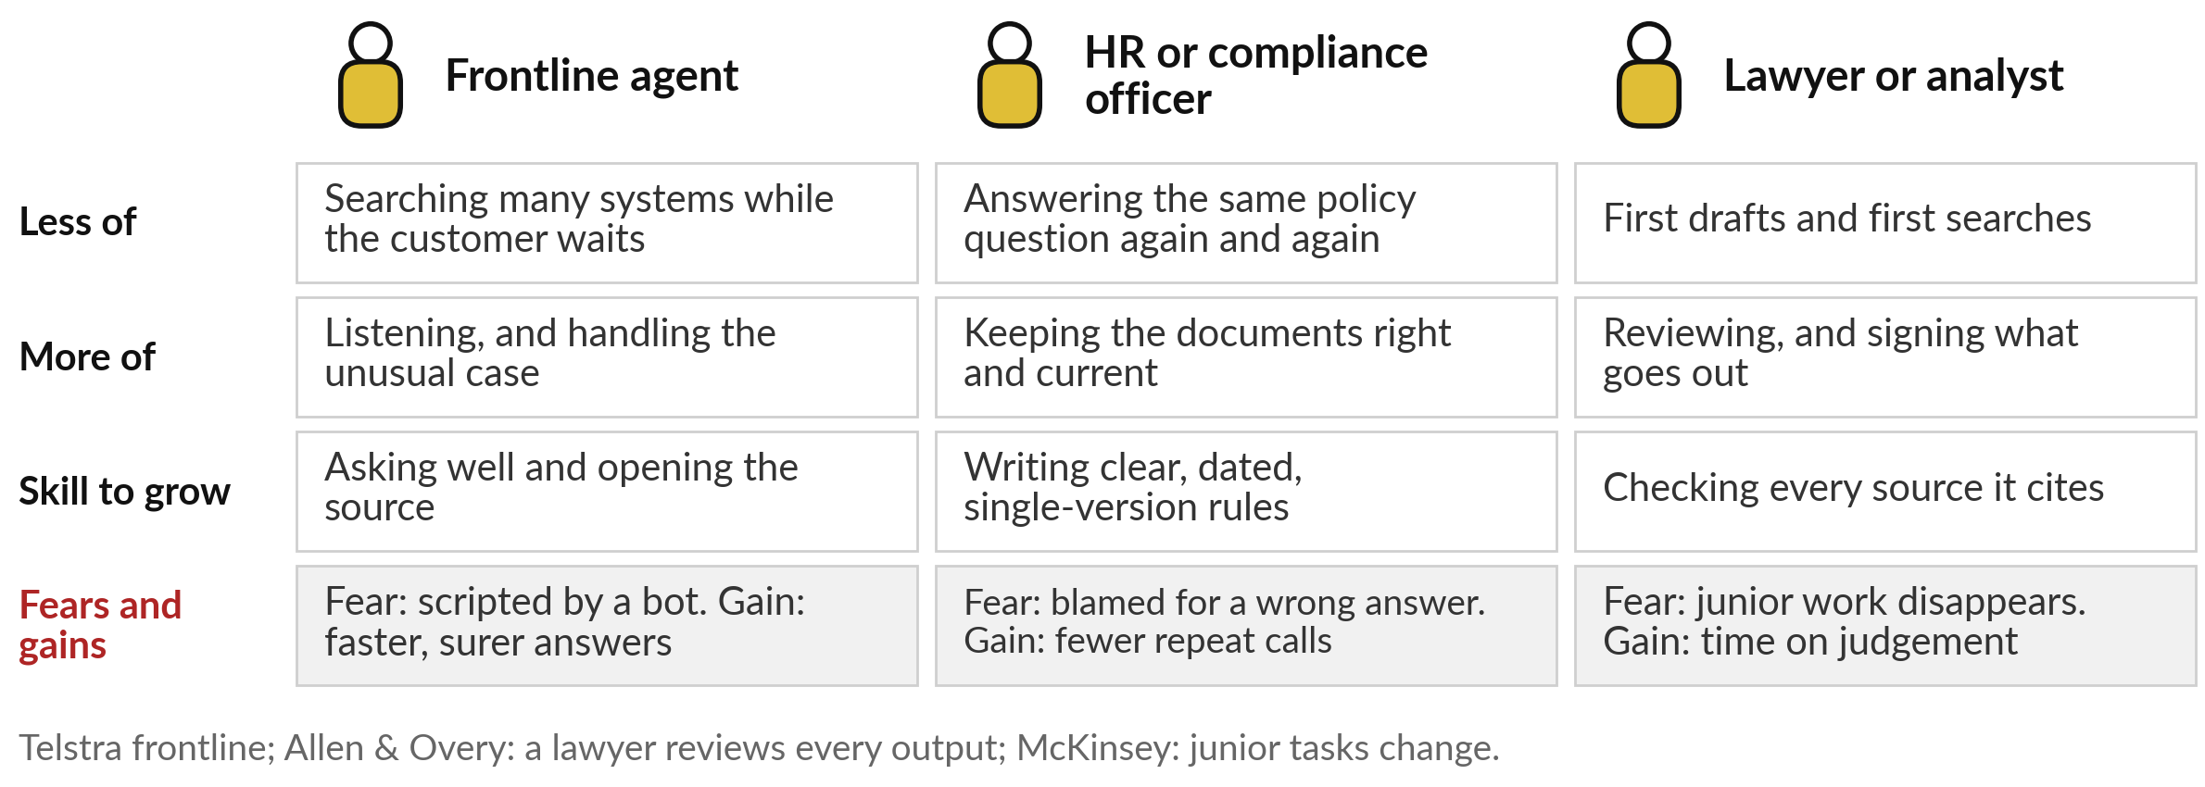
Your people: frontline staff search less, and
policy owners and reviewers matter more
Bank of America says its staff assistant is used by over 90% of employees and halved IT desk calls.
Notes:
We turn to your people, because these tools change who does what. Frontline agents, like Telstra’s, search less and spend more time on the customer and the unusual case. The new skill is asking well and opening the source. HR and compliance officers stop answering the same question all day and take on keeping the documents right.
Lawyers and analysts get first drafts and searches; at Allen and Overy every Harvey output is reviewed by a lawyer. Bank of America says its staff assistant is used by over 90 per cent of employees and halved calls to the IT desk. Octopus Energy keeps sensitive and vulnerable customers with staff.
What do your frontline staff fear about this today?

Slide 28
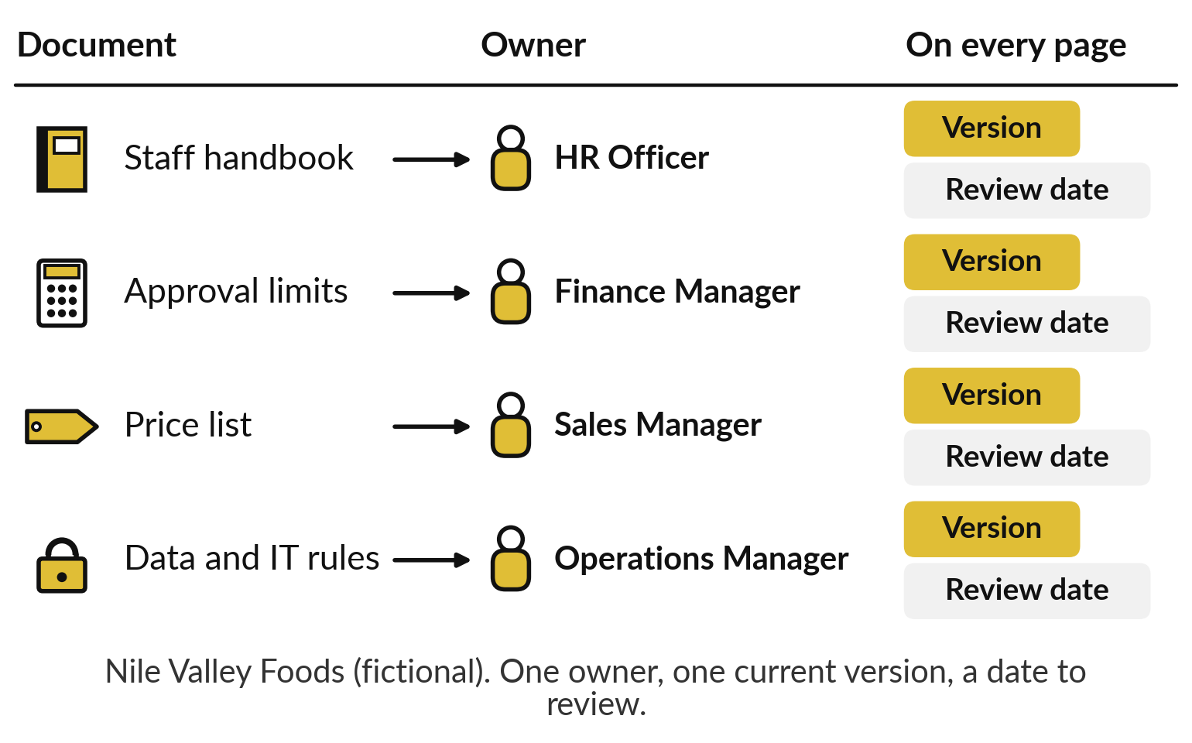
The keepers of knowledge become
owners of the source documents
Every document an assistant reads needs one owner, one version and a review date.
HR owns the handbook; finance owns the limits.
One current version; old ones archived.
A review date on every page.
Notes:
Whatever your staff fear, one change is certain. The people who keep knowledge, in HR, compliance, finance and product, become owners of the documents the assistant reads. Here it is for our fictional company. The staff handbook belongs to the HR Officer, the approval limits to the Finance Manager, the price list to the Sales Manager, the data and IT rules to the Operations Manager.
Each document carries a version number and a review date, and only the current version is in the assistant’s library. When the price changes, the owner changes the page, and the next answer changes with it. Session 14 returns to this when we check your data is ready. Now, the questions to ask.

Slide 29






Questions to ask your team and your vendor
before you trust a document assistant
Ask | Why it matters
Which documents may it read, and who owns each one? | Messy or out-of-date pages give wrong answers
Does every answer name its source, and can staff open it? | A source lets anyone check in seconds
What does it say when the documents are silent? | “Not stated” is safer than a guess
How were the documents cut, and was it tested? | A bad cut hides answers that are there
Could we paste the document instead of building search? | Start on the lowest step that works
Where do our documents go, and who else can see them? | Check data location and Uganda’s data law
Notes:
Everything so far comes down to six questions. Ask which documents it may read and who owns each, because messy pages give wrong answers. Ask whether every answer names its source and staff can open it. Ask what it says when the documents are silent; not stated is safer than a guess.
Ask how the documents were cut and whether that was tested on known answers. Ask whether you could simply paste the document before paying for search. And ask where your documents go and who else can see them, which brings in data location and Uganda’s data protection law from Session 6; check the details with your lawyer. Now we put these to work on your own organisation.

Slide 30
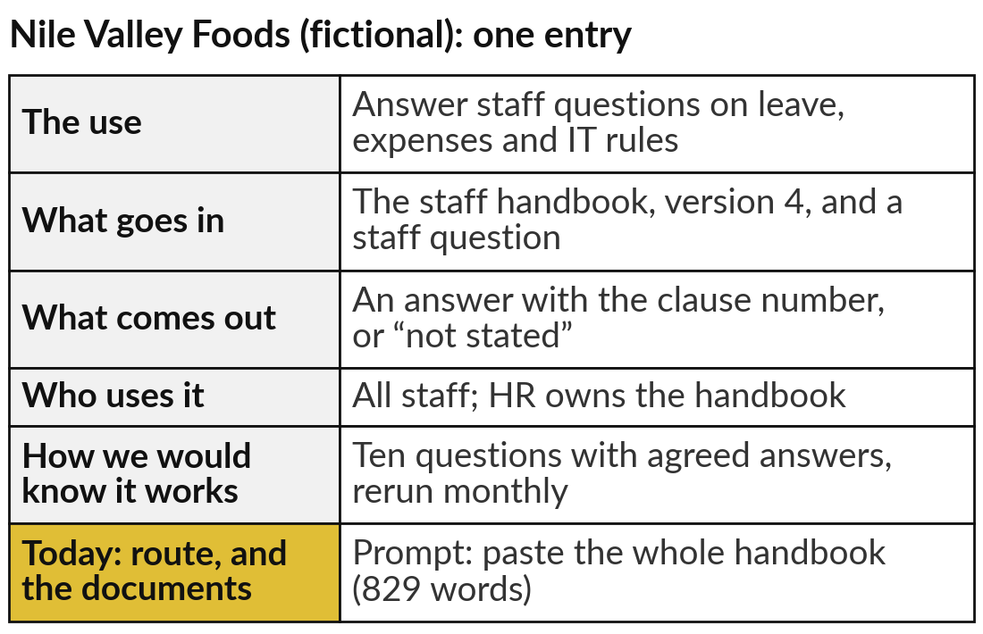
Add a knowledge assistant to
your AI Opportunity Portfolio
25 minutes
Hands-on: your portfolio
Pick a question your staff or customers ask again and again.
Name the question and the documents that answer it.
Fill the five columns, as in the example.
Add today’s column: prompt, retrieve or customise, and the documents.
Name the owner of each document.
You keep: One knowledge assistant in your portfolio, with its documents and their owners.
Notes:
For twenty-five minutes you work on your own organisation, and I walk round. Open the AI Opportunity Portfolio in your workbook. Pick a question your staff or customers ask again and again: leave rules, product terms, loan conditions, a procedure. Name the documents that answer it. Fill the five columns: the use, what goes in, what comes out, who uses it, and how you would know it works.
Then today’s column: the route, prompt, retrieve or customise, and the documents it reads. Last, name the owner of each document, and note any document that is out of date or exists in two versions. The example on the right is for Nile Valley Foods, our fictional company.

Slide 31




For your first knowledge assistant,
which step of the climb do you start on?
For the assistant you just wrote, which route would you start with, and why?
Prompt
Retrieve
Customise
Fix first
Paste a short document into a good brief
Many documents, changing facts, answers with sources
A house style at large volume, with facts from documents
Our documents are out of date, duplicated or missing
Write your decision and the reason in your workbook.
Notes:
With your entry written, one decision. For that assistant, which step of the climb do you start on?
Prompt, if the documents are short enough to paste into a good brief. Retrieve, if they are many, change often, or each answer must show its source. Customise, only if you need a house style at large volume, with the facts still coming from the documents. Or fix first, if your documents are out of date, duplicated or missing.
That is an honest and useful answer, because cleaning them is the first project, and Session 14 helps you plan it. Tell me your choice and the reason.

Slide 32
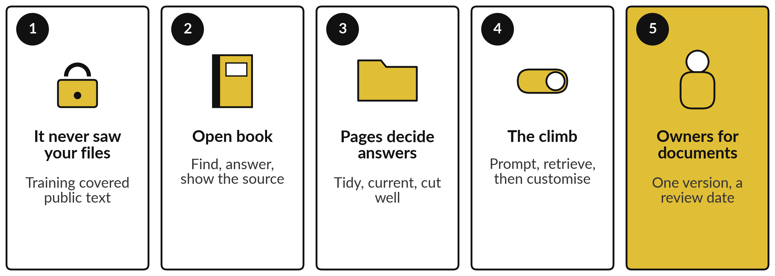
Take-away: five things to remember
Notes:
Here is the session in five lines. A general assistant never saw your files; training covered public text. To answer from your documents it takes an open-book test: find the right pages, answer from them, show the source, which the industry calls RAG. The pages decide the answers, so keep them tidy and current, and cut them well.
Climb in order: prompt, then retrieve, then customise, and customise for style only. And every document needs an owner, one version and a review date. Our recorded runs went from 2 to 10 right out of 10 when given the right pages. Now, what you take away.

Slide 33
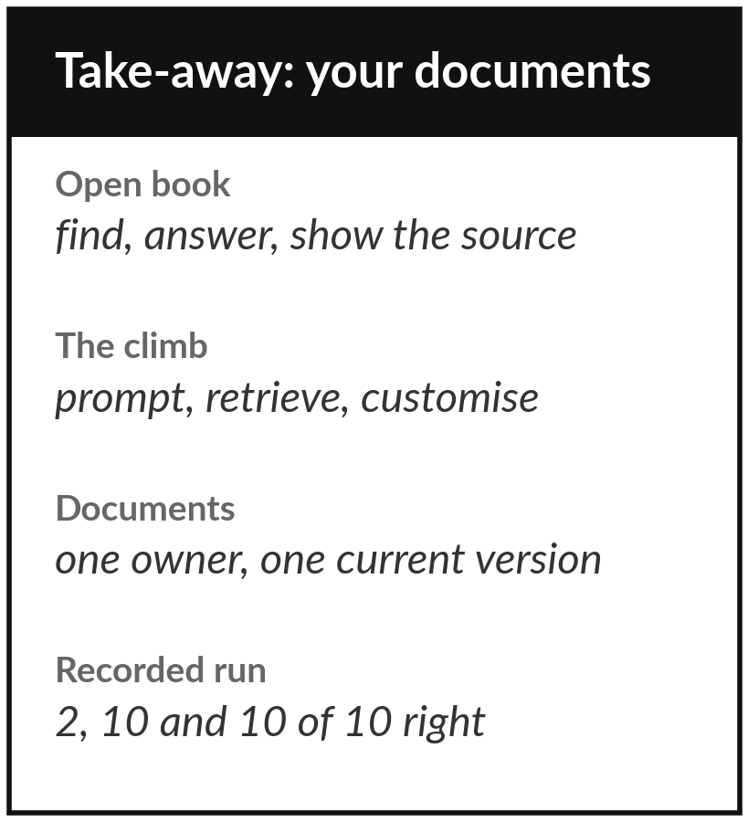
Keep the sheet, and the knowledge
assistant you added to your portfolio
What you keep from today
A one-page sheet: the open-book picture, the climb from prompt to retrieve to customise, the document checks, the questions to ask, today’s recorded scores, and your new portfolio entry.
Our question today
How does AI answer from our policies, products and files, and how far can we trust what it says?
Next session
Session 9: When AI goes wrong: failures, risk and checking.
Notes:
Keep the take-away sheet. It has the open-book picture, the climb from prompt to retrieve to customise, the checks for your documents, the questions for your team and vendor, and today’s recorded scores: 2 of 10 with no handbook, 10 of 10 with the three closest clauses, 10 of 10 with the whole handbook pasted.
Your portfolio now holds a knowledge assistant with a named document owner. In Session 9 we turn to what still goes wrong, what it cost others, and how we check.
We began with this question: How does AI answer from our policies, products and files, and how far can we trust what it says? Before you go, say in one sentence what you can now say about it.

